Slide 1
Meeting management

Slide 2
Pre Meeting Prep
3 TO 5 DAYS PRIOR TO THE MEETING
Secretary Minutes
Treasurer’s Report
Committee Reports
Create Agenda
Check in with officers the day before the meeting, make sure that all items have been included in the agenda

Slide 3
The power of(PRE) communication

Slide 4
Making sure reports are ready (UTILIZE TEMPLATES, SHARED DRIVES, ETC)
Secretary minutes should include date, those in attendance, agenda, discussion, any motions made and the outcome (vote counts).
Treasurer reports should include a copy of the approved budget for the year. Any expenditures and receipts that have come in since the last meeting, and how/what category they fit within on the approved budget.
All committee representatives should explain what the poser of the committee that they resent is, speak and share any items that were discussed at their most recent meeting, they should also try to gather any information that may need to go to their committee.
Agenda should be created referencing the last meeting, changing new business to old business and removing any items that were completed.

Slide 5
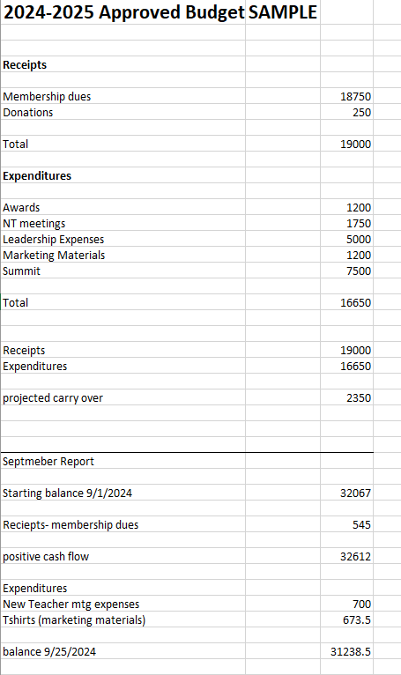

Slide 6
Setting up the agenda
Date, location, purpose of meeting
Reports
Old Business
New Business
Open for Comment
Next Meeting

Slide 7
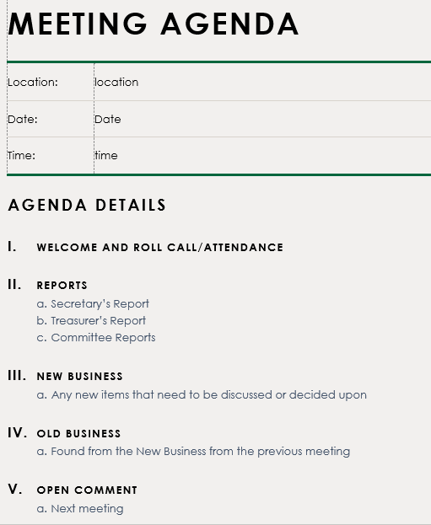

Slide 8
General Roles and procedures
Following Robert’s Rules of Order. Maintain order, allow full discussion of all items and get through the agenda items in a timely fashion.
Chair- HARD RULES
Cannot make motions (EVER)
Is supposed to stay neutral
Should keep own opinion very quiet and neutral
CAN HELP direct the work by referring to by laws, and other documentation, can help correct motions made so that they are germane.

Slide 9
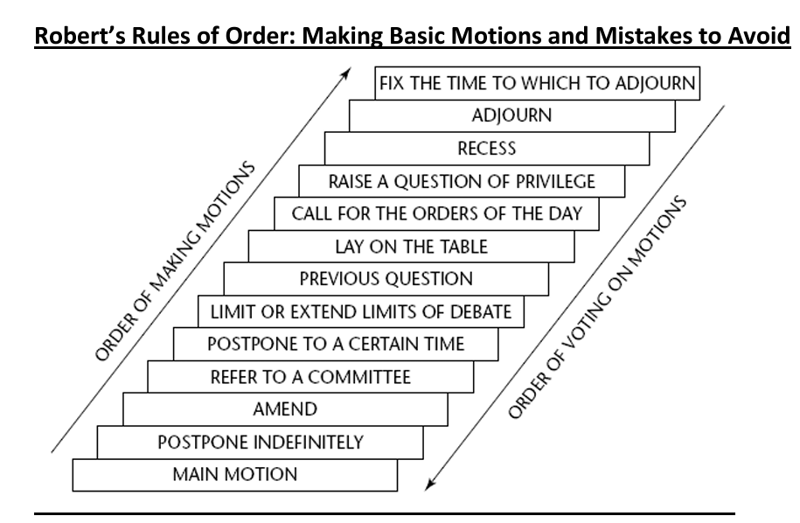
Basic motions and Parli pro
I move…
NEVER I motion
I move to…

Slide 10
Wrap up of meeting
Consistency is key
If motions were passed, remind the attendees as to what they were and when changes will take place.
Remind everyone where they can find the minutes to review before the next meeting (post on webpage/email out).
Have a shared drive where materials can be shared and stored for the officers.
Thank the participants for attending and being a part.
As a team
Give and receive feedback
Perfect the process together

Slide 11
What questions do you have?
Renee Reed
405-743-5145
renee.reed@careertech.ok.gov

