Slide 1
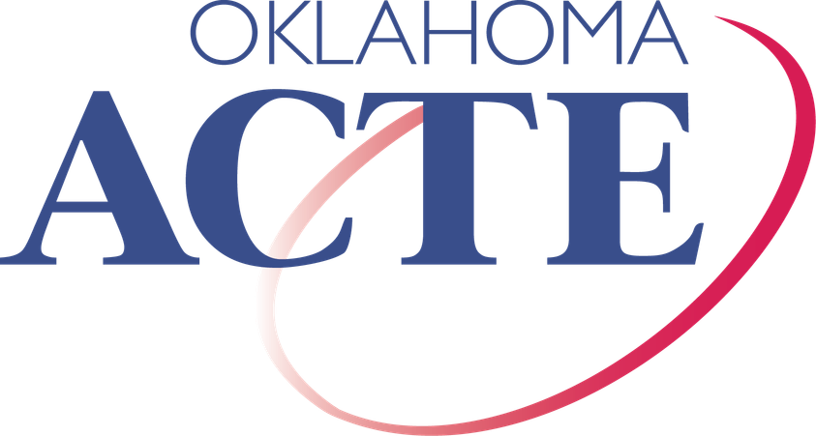
State Questions 844, 847 & 843
The Impact on Oklahoma Communities

Slide 2
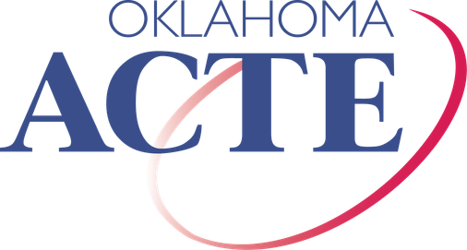
UNDERSTANDING THE ISSUES:
The role local property taxes play in Oklahoma communities
What State Questions 844, 847 and 843 propose What these changes could mean for local communities

Slide 3
WHAT ARE PROPERTY TAXES (AD VALOREM TAXES)?
Ad valorem taxes are local property taxes paid on real estate.
Unlike state income or sales taxes, this money stays in the local community where it is collected.

Slide 4
HOW ARE LOCAL PROPERTY TAXES USED?
Property taxes stay LOCAL.
Public schools
CareerTech
Local Property Owner
County Treasurer
County Government
Local elected officials determine community priorities.
Libraries Health EMS
Roads & bridges Other local districts

Slide 5
HOW MANUFACTURING PROPERTY TAX REIMBURSEMENTS WORK TODAY
Qualifying manufacturing facilities receive a five-year exemption from local property taxes.
Manufacturing Property Tax Exemption
The Oklahoma Constitution requires the state to reimburse local entities for the exempted property tax revenue.
Local Property Tax Revenue Reduced
Reimbursements support community services like K-12 public schools, EMS services, libraries, health departments and CareerTech.
State Reimbursement
Public Education, Libraries Health, EMS, CareerTech Roads & bridges

Slide 6
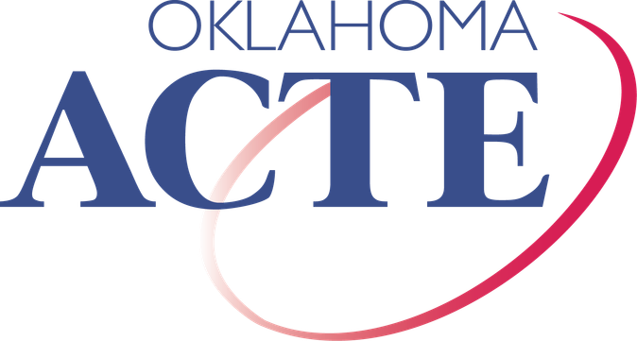
State Question 844

Slide 7
WHAT DOES SQ 844 PROPOSE?
SQ844 changes how K-12 schools, CareerTech and communities are reimbursed for property tax revenue lost through Oklahoma’s manufacturing ad valorem tax exemption program.
If approved:
Future reimbursement would no longer be protected in the Oklahoma Constitution.
Instead, the state Legislature would determine reimbursement amounts and methodology.
ON THE BALLOT: AUGUST 25, 2026

Slide 8
HOW WOULD SQ 844 IMPACT
COMMUNITIES?
Without constitutional protections, future Legislatures could reduce reimbursement for lost property tax revenue.
This could result in less funding for K12 schools, the CareerTech system and essential community services.

Slide 9
State Question 847

Slide 10
WHAT DOES SQ 847 PROPOSE?
SQ 847 limits how quickly taxable property values can increase each year.
Reduces general property caps from 5% to 4% for 2027 onward Reduces annual growth limit for qualifying homestead exemptions and agricultural land from 3% to 1.75%
Adjusts senior tax protections
Over time, lower growth limits on taxable property values would slow the growth of local property tax revenue, impacting funds available for schools, the CareerTech system and community services.
ON THE BALLOT: NOVEMBER 3, 2026

Slide 11
HOW WOULD SQ 847 IMPACT
COMMUNITIES?
SQ 847 is estimated to reduce funding to Oklahoma’s CareerTech system by more than $100 million over the first 10 years.
Slower property value growth = slower local revenue growth Revenue growth may not keep pace with inflation
Would affect K-12 resources, class sizes and CareerTech student opportunities
Would limit CareerTech program expansion and workforce training capacity CareerTech was established to grow through local ad valorem funding

Slide 12
State Question 843

Slide 13
WHAT DOES SQ 843 PROPOSE?
SQ 843 gradually eliminates property taxes on owner-occupied homes over three years:
Property Tax Revenue Reduction % Under SQ 843
100
2027: $400M reduction
80
2028: $800M reduction
60
2029: $1.2B reduction
40
20
0% | 33% | 66% | 100%
2026 | 2027 | 2028 | 2029
0

Slide 14
OVERALL IMPACT
Estimates show State Question 843 could reduce local revenue by approximately
$1.2 billion per year

Slide 15
HOW WOULD SQ 843 IMPACT
COMMUNITY SERVICES?
Less local revenue available to support community priorities like K-12 education, emergency medical services, law enforcement, roads and bridges, and CareerTech.

Slide 16
CURRENT STATUS OF SQ843
SQ 843 is currently under review by the Oklahoma Supreme Court.
If the Court rules... | What happens next?
Unconstitutional | SQ 843 does NOT move forward
Constitutional | SQ843 could be placed on a future statewide ballot

Slide 17
SQ 844, 847, 843:
Statewide Impact on Local Communities

Slide 18
Q: IF LOCAL PROPERTY TAX REVENUE GOES AWAY, WHAT REPLACES IT?
A: THERE IS NO IDENTIFIED REPLACEMENT FUNDING SOURCE.

Slide 19
Q: WHY DOES THIS MATTER TO OUR
COMMUNITY?
A: Stable funding allows communities to maintain these services, plan for the future and respond to local needs.

Slide 20
Q: ISN’T PAYING PROPERTY TAX LIKE RENTING FROM THE GOVERNMENT?
A: No, your property tax dollars do NOT go to the state.
The facts:
Oklahoma does not have a state property tax. Property taxes are not used for state programs.
Property tax is a tax for community services you use every day.
You help decide how funding is used through your local elected leaders and votes.

Slide 21
Q: IF PROPERTY TAXES ARE REDUCED, WON’T GOVERNMENTS JUST SPEND LESS?
A: No, the cost of operating critical community services does not disappear when revenue declines - it creates a funding GAP that must be filled.
Communities would face three difficult choices: Reduce services
Shift costs to other taxpayers
New service tax on individuals, commercial or agriculture Seek replacement funding from the state

Slide 22
WHAT IF LOCAL FUNDING DECLINES?
Larger K-12 class sizes and reduced academic programs Fewer educational opportunities
Slower emergency response
Delayed road and bridge maintenance
Decline in library services and community programs Reduction in workforce training opportunities
Hindered economic development and slower business growth

Slide 23
ELECTION DATES
SQ 844: Tuesday, August 25, 2026
SQ 847: Tuesday, November 3, 2026
SQ 843: Pending Oklahoma Supreme Court Decision

Slide 24
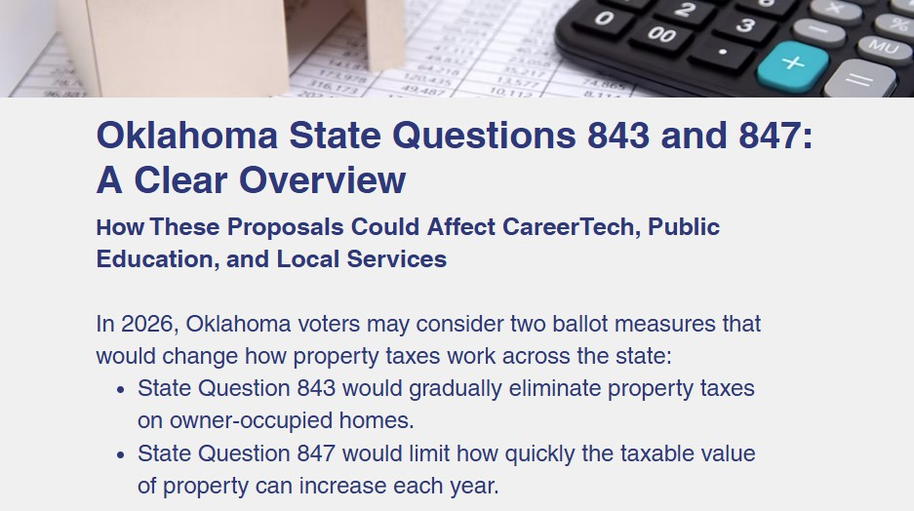
WHERE CAN I LEARN MORE BEFORE VOTING?

Slide 25

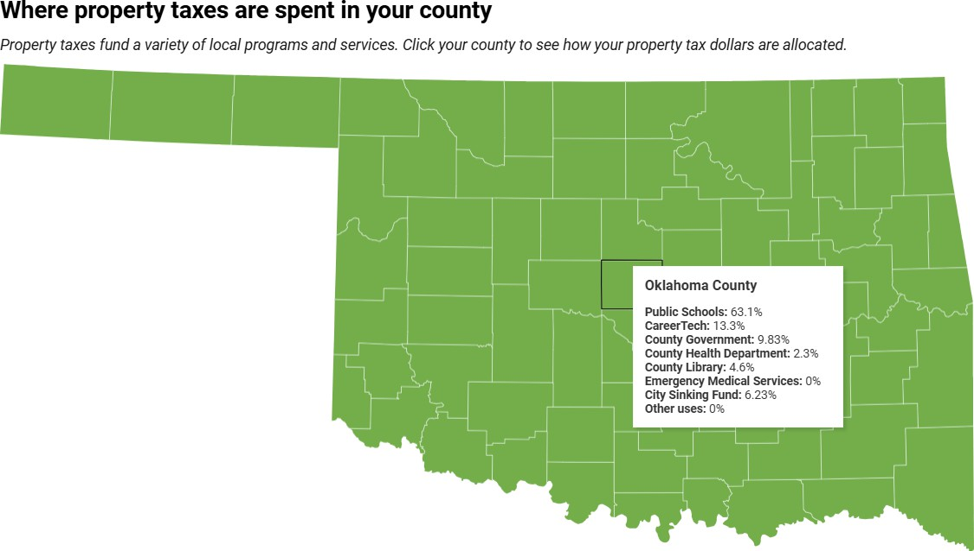
WHERE DO YOUR LOCAL PROPERTY TAX DOLLARS GO?

Slide 26
OkACTE opposes State Questions 844, 847 and 843.
OKACTE’S OFFICIAL POSITION
We urge all members to
Vote NO

Slide 27
QUESTIONS?
Skye McNiel smcniel@okacte.org

