Slide 1
Cyberbullying: The Silent Threat
Understanding the impact of online harassment today
Notes:
---

Slide 2
Introduction
Michael Martin IT Executive Director of Client Experience
Notes:
---

Slide 3
Presenter Introduction
Presenter Background
  Michael Martin has over 23 years of experience in higher education technology leadership roles.
Leadership Approach
  He emphasizes resourceful, people-first leadership fostering trust and innovation in technology teams.
Presentation Focus
  The presentation addresses cyberbullying using AI and psychological models for detection and intervention.
Technology and Well-being
  Combining AI innovation with psychology to promote well-being and support victims of cyberbullying.
Notes:
Presenter: Michael Martin, Executive Director of IT Client Experience
Michael Martin brings over 23 years of experience in higher education technology, having held pivotal roles such as ERP System Administrator, IT Director, and Chief Information Officer (CIO). Currently serving as the Executive Director of IT Client Experience at the University of Central Oklahoma, he oversees critical areas including the IT Service Desk, Technology Support, and the Academic Research and Technology Center. His leadership style is resourceful and people-first, emphasizing the importance of trust-based teams and unified environments where technology fosters connection, innovation, and success. Martin’s extensive background and strategic vision position him as a thought leader in leveraging technology to address pressing social issues like cyberbullying.
Presentation Focus
This presentation delves into the urgent issue of cyberbullying, framing it as a real social emergency. It integrates cutting-edge Artificial Intelligence (AI) algorithms and psychological models to explore both the threats and solutions posed by modern technology. While AI introduces new challenges such as deepfakes and automated harassment, it also offers powerful tools for identifying violent episodes and combating bullying. The discussion aims to highlight how AI can be harnessed to promote human well-being, detect harmful behaviors, and support victims through intelligent intervention systems. By combining technological innovation with psychological insight, the presentation seeks to provide a comprehensive understanding of cyberbullying and actionable strategies to mitigate its impact.

Slide 4
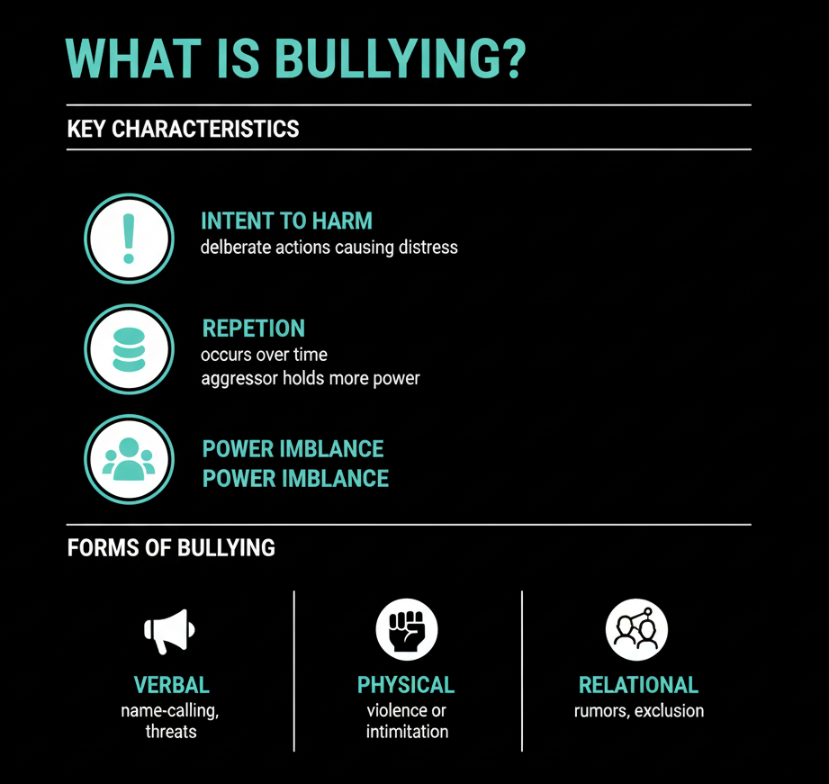

Slide 5
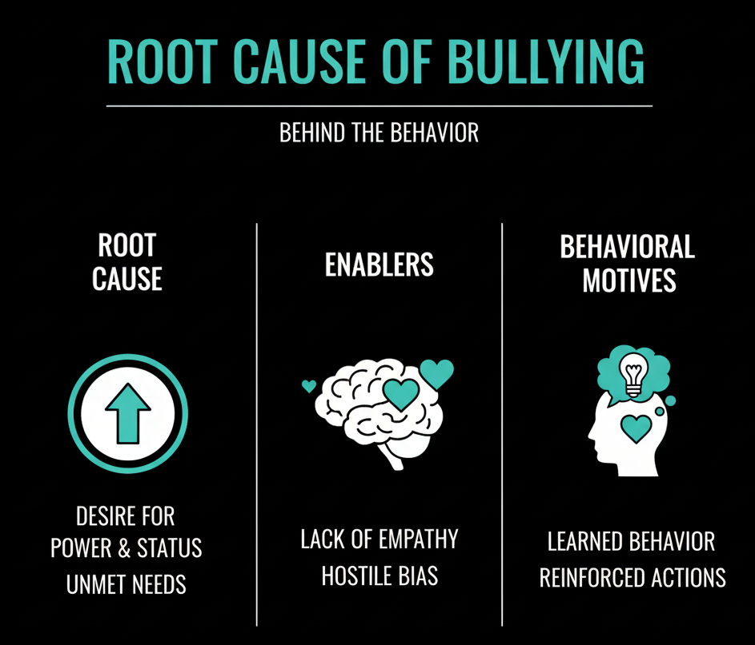

Slide 6
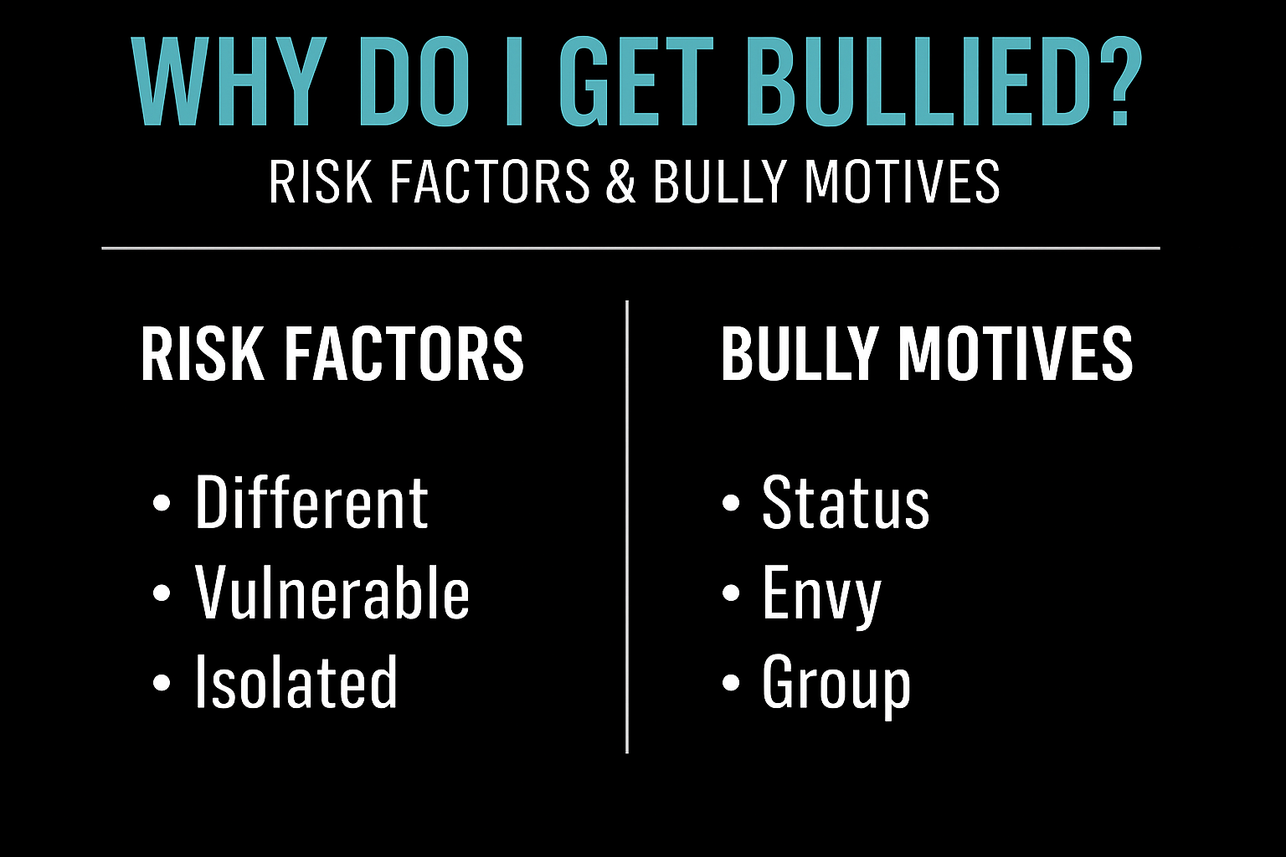


Slide 7
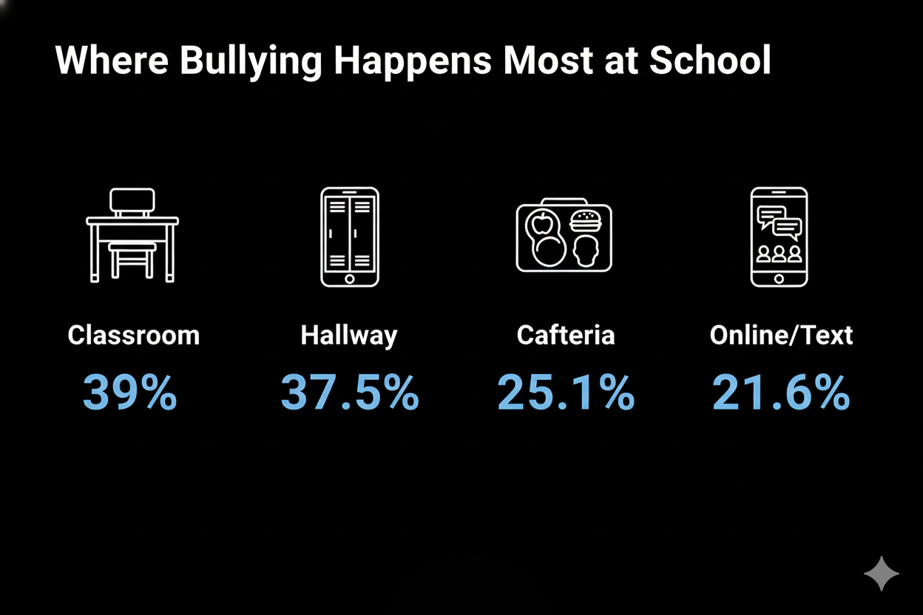
Bullying & Cyberbullying Statistics (2025): Trends, Risk Groups & Help — South Denver Therapy

Slide 8
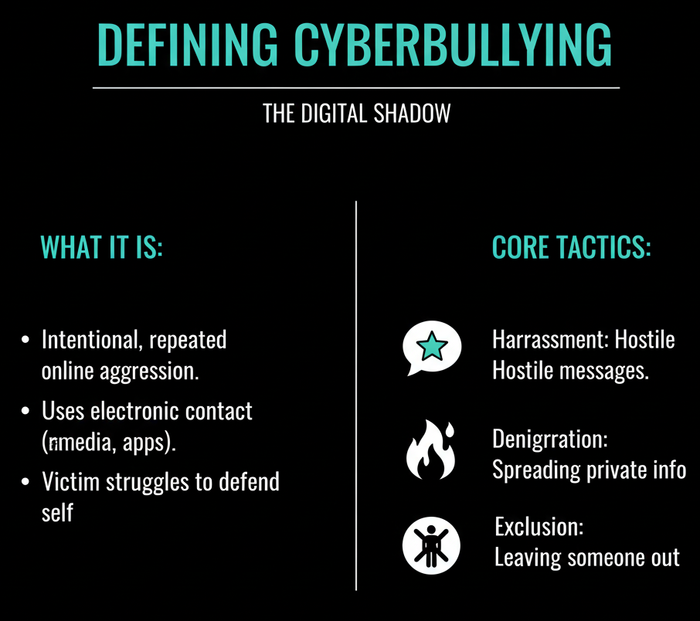



Slide 9
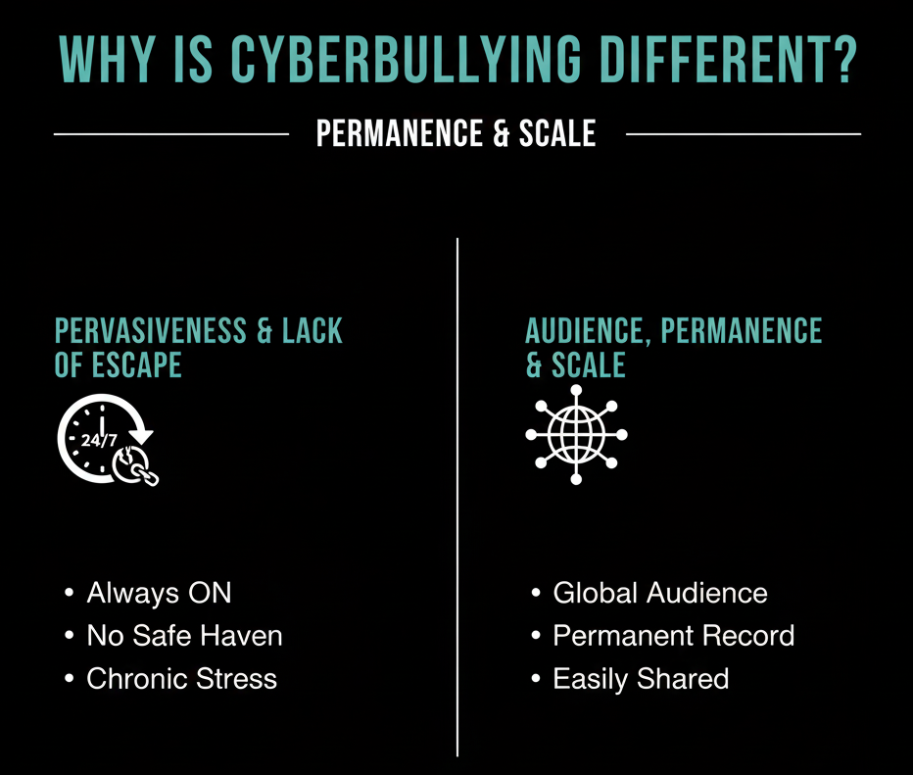

Slide 10
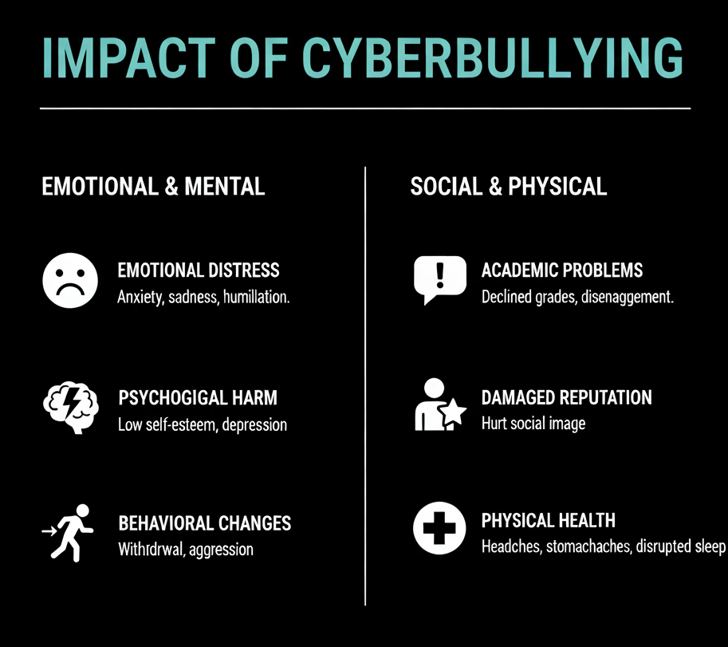
Psychological Harm

Slide 11
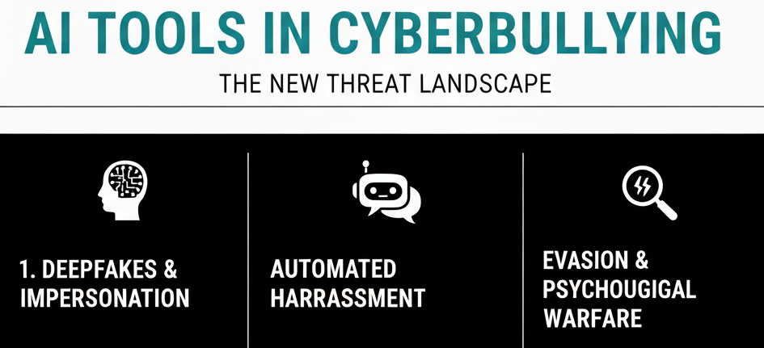

Slide 12
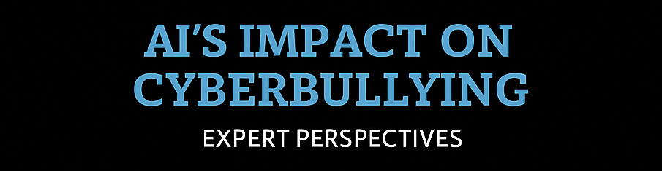

"AI can amplify and reach increase speed of cyberbullying content, making it harder to contain."
  – Dr. Kimberly Schonert-Reichl, UBC
"Deepfakes and AI-generated misinformation represent a terrifying frontier, blurring the lines of reality for victims."
– TechCrunch Report
"The arms race between AI for moderation and AI for malicious content is constantly escalating."
– David Ryan, CyberLaw Professor

Slide 13
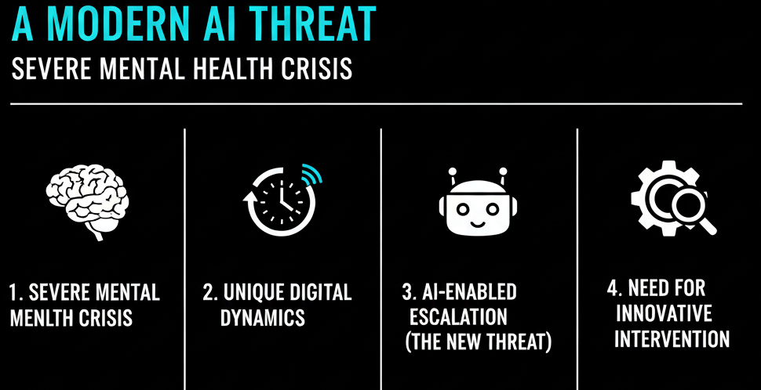

Slide 14
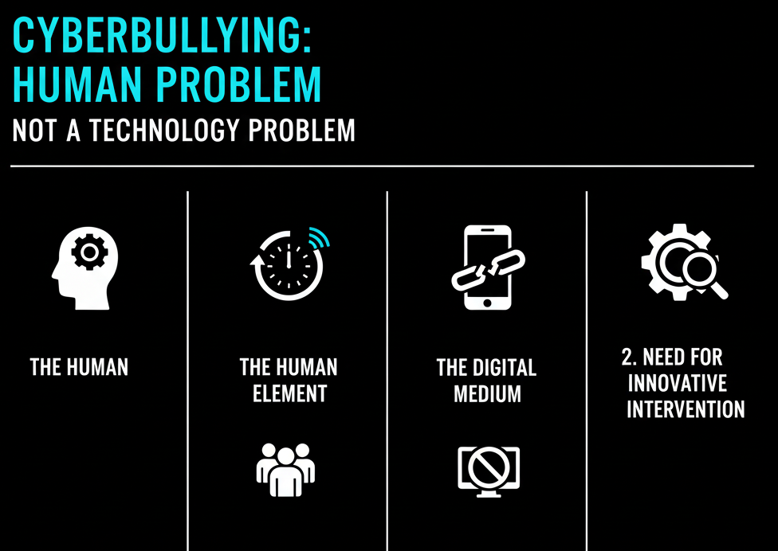
?

Slide 15
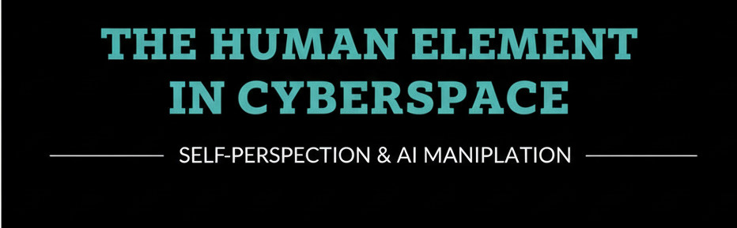
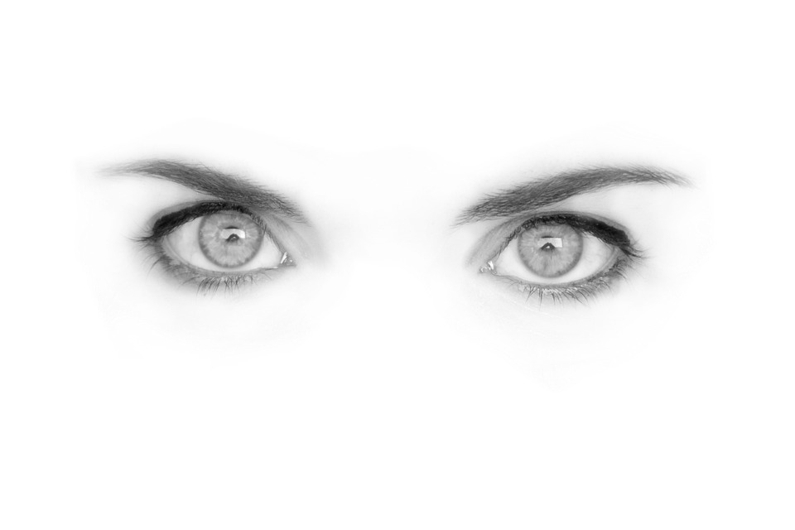
Nobody comes to the Cyber landscape with a blank self-perception. Everyone enters cyberspace with a mixture of positive and negative ideas about themselves and others. We are all at risk of manipulation and exploitation at an exponential level with ubiquitous AI integrated into technology ,social interaction and communication.

Slide 16
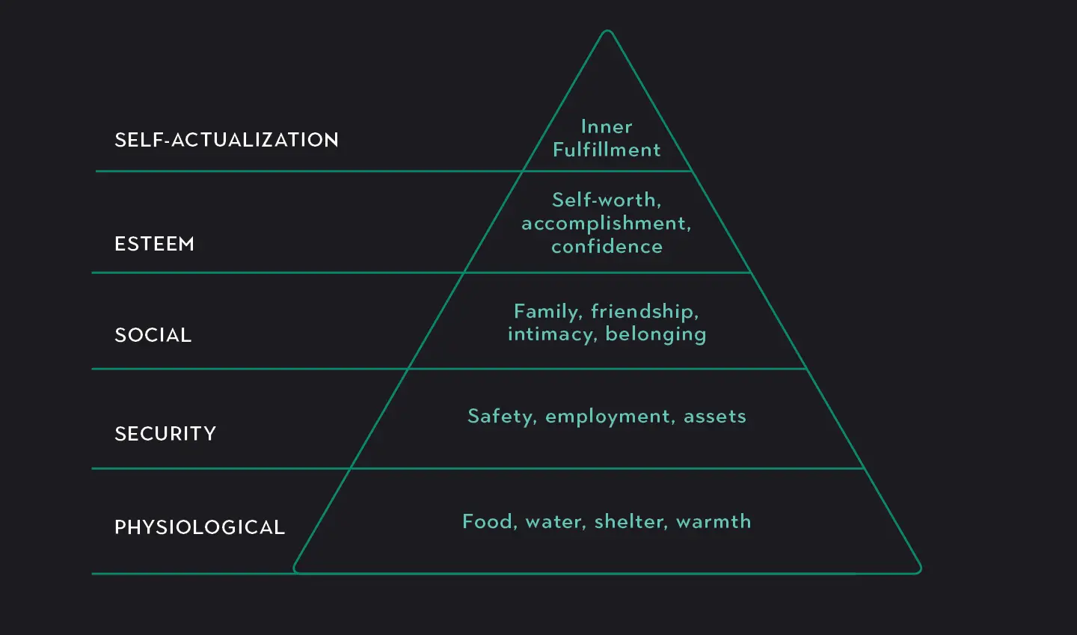



Slide 17
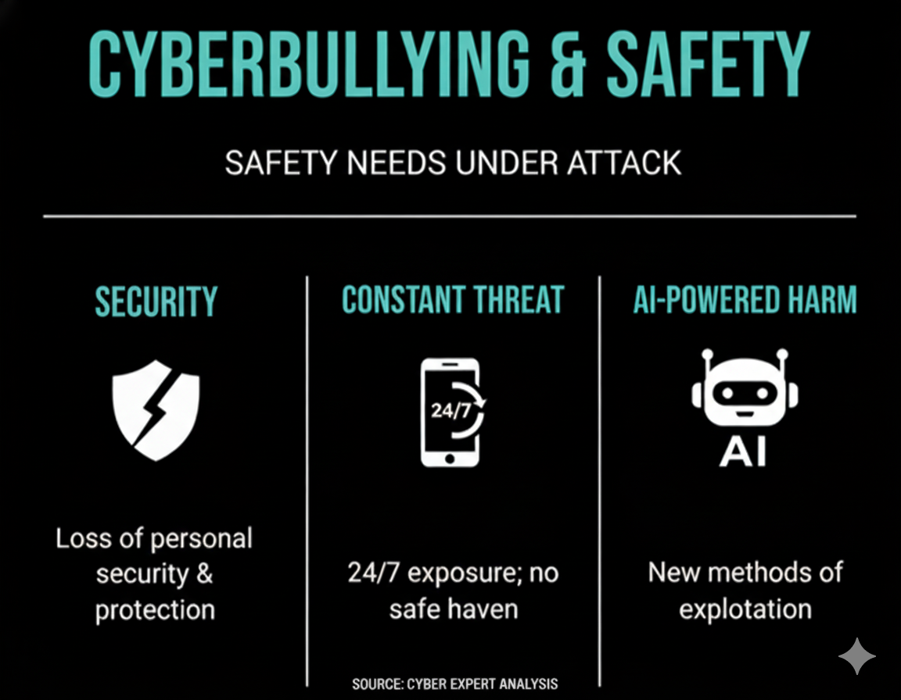

T

Slide 18
Survival Mode: When safety is compromised, the victim is instantly forced into survival mode. The focus shifts from growth ("Who can I become?") to "How will I survive today?

Slide 19
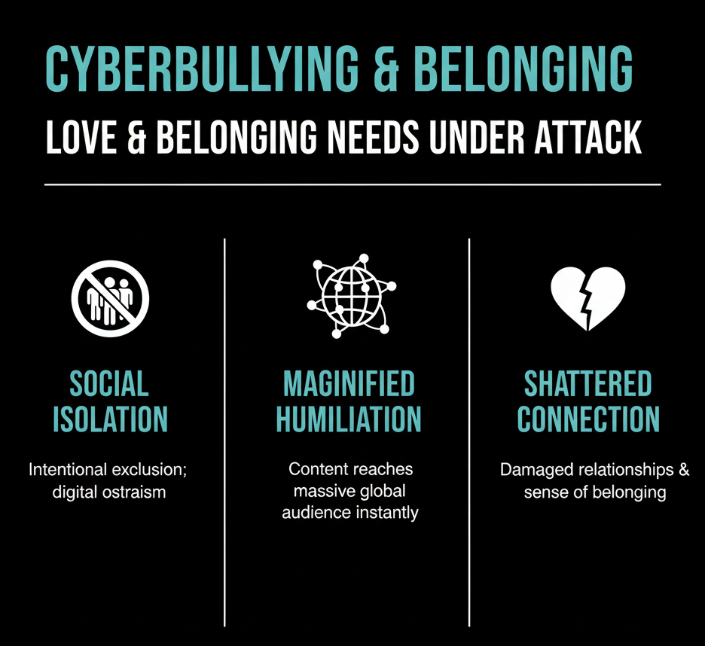
Abraham Maslow

Slide 20
Belonging: “The need for love, affection, and belongingness is a fundamental human need.”
(Paraphrased from Maslow’s writing in Motivation and Personality.)

Slide 21
Despite the various negative psychosocial outcomes that can result from cyberbullying involvement, social connectedness, which refers to the sense of belonging and connection to others, plays a crucial role in mitigating the adverse effects of cyberbullying. Strong social ties provide emotional support, which can enhance resilience and help individuals cope with the stress and emotional strain associated with cyberbullying (McLoughlin et al., 2018).
Longitudinal insights into the neurophysiology of cyberbullying involvement in adolescence: A Bayesian approach using EEG spectral power - ScienceDirect

Slide 22
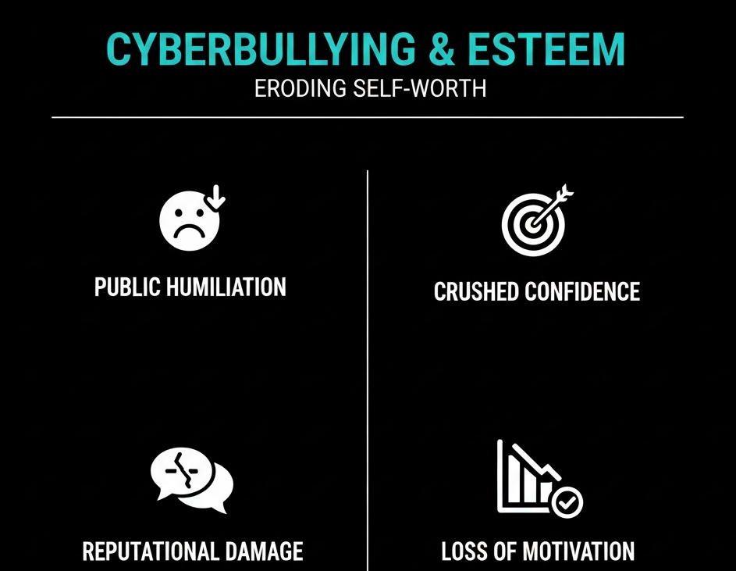

Slide 23
"A positive self-image and healthy self-esteem is based on approval, acceptance, and recognition from others; but also upon actual accomplishments, achievements, and success upon the realistic self-confidence which ensues."
Abraham Maslow

Slide 24
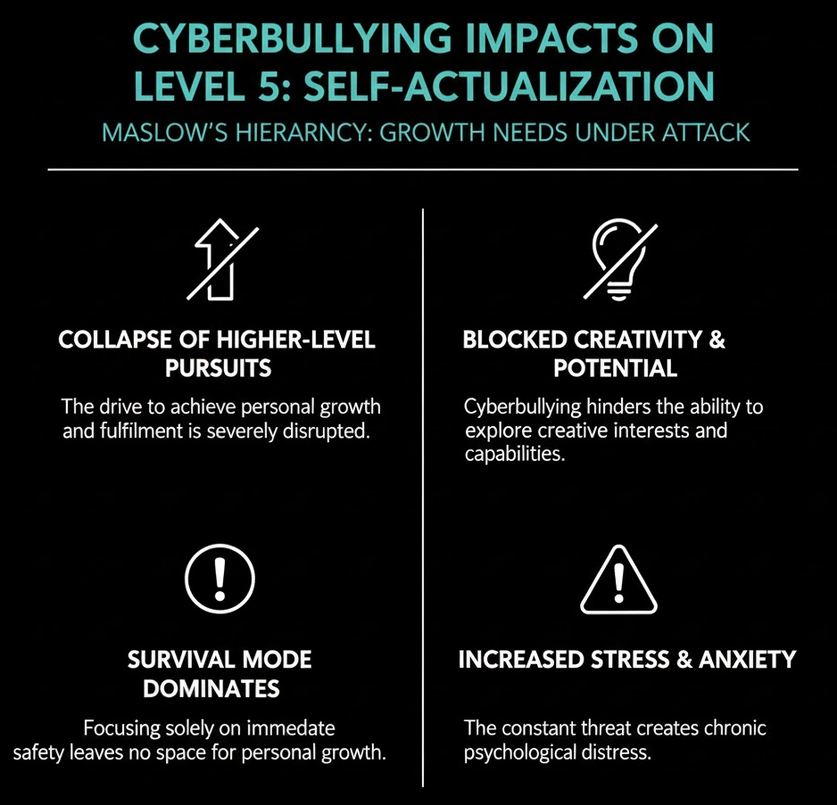

Slide 25
"Self-actualization is the full use and exploitation of talents, capacities, and potentialities."
Abraham Maslow

Slide 26
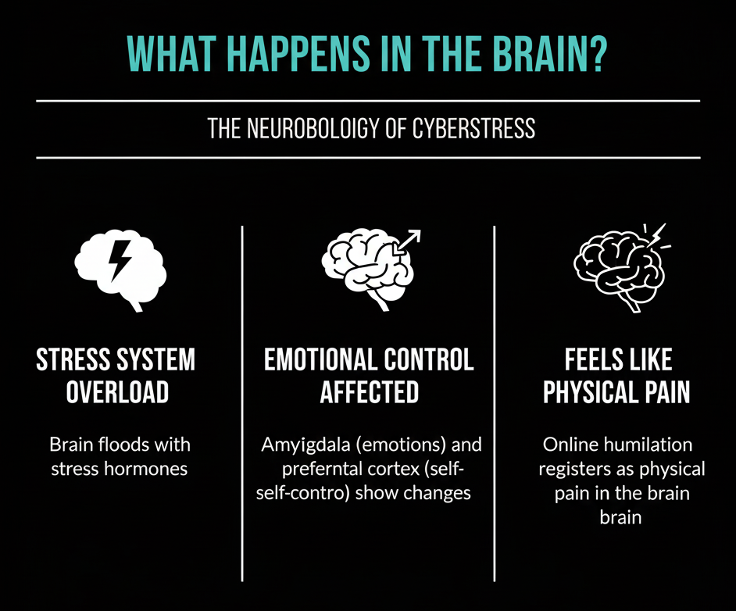

Slide 27
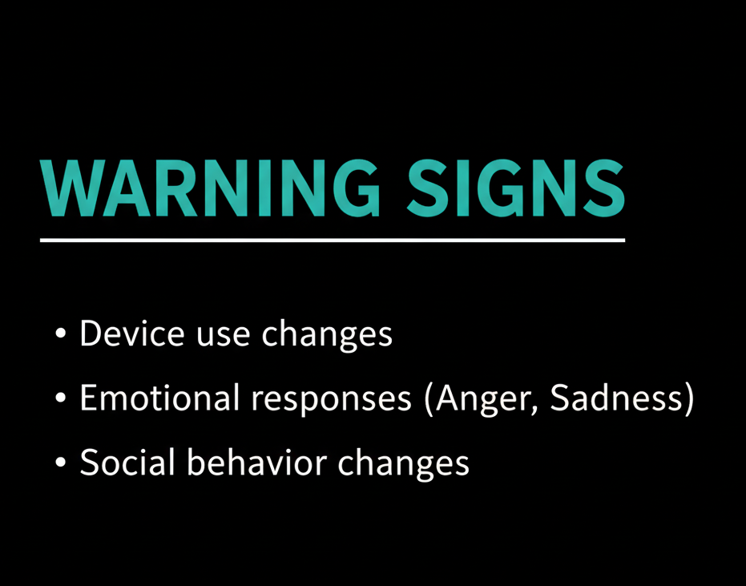
Device use changes (up/down)
Emotional responses (laughter, anger)
Hides screen, avoids talk.
Social behavior changes
Avoids social situations.
Withdrawn, depressed
Shuts down old/new accounts

Slide 28
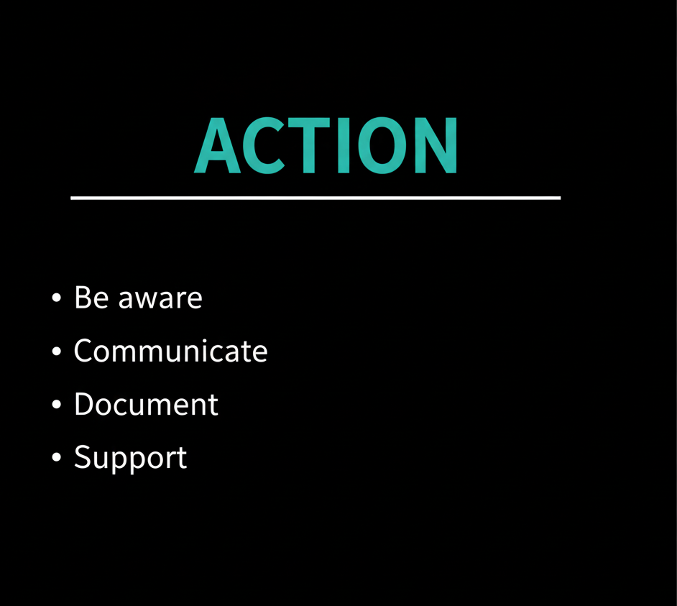


Slide 29


Story 1: Carla's Experience - Fake Accounts & Impersonation
Initial Attack & Confusion
Carla's friends and peers were upset, accusing her of saying horrible things she never said.
She felt confused and isolated as she didn't know the source of the conflict.
Discovery & Emotional Toll
A friend discovered the source: a fake Instagram account created to look exactly like Carla’s.
The imposter account was posting nasty captions about other girls.
Carla felt humiliated and anxious, having to constantly defend herself as the fake accounts kept reappearing on multiple apps.
Intervention & Resolution
Reporting to Instagram and other platforms failed to stop the posts.

Slide 30

Story 2: Syed's Experience - Physical Attack & Online Humiliation
Physical Confrontation: Syed and his friend Tom were picked on by older guys at school. They were followed, and eventually, Tom was held while Syed was hit and kicked. Syed chose not to fight back.
Video Shared Online: After the attack, Tom revealed one of the attackers had filmed the incident. The video was later shared online, making Syed feel "sick" due to humiliating comments calling him "embarrassing and pathetic."
School Action: Syed and Tom showed the video to a teacher, leading to the attackers' suspension. While the school asked for the video to be deleted, it remained online.

Slide 31

Story 3: Jacqueline's Experience - Non-Consensual Sharing of a Vulnerable Moment at a Party
Incident: Jacqueline, underage, drank alcohol for the first time at a house party and lost control, with friends laughing at her behavior. She had limited recollection of the night.
Discovery of Video: The next morning, a friend alerted her to a video posted online showing Jacqueline slurring words and stumbling, with a humiliating caption and thousands of views and reposts across platforms.
Emotional Impact & Fear: Jacqueline initially tried to laugh it off but soon realized the widespread reach. She was most worried about her conservative parents finding out, both about her underage drinking and the non-consensual sharing of her vulnerable moment. Her parents, though disappointed, focused on helping her remove the content.
Escalation & Humiliation: The situation worsened as more copies of the video were shared, with people tagging her, making jokes, and strangers commenting. She found it deeply humiliating.

Slide 32
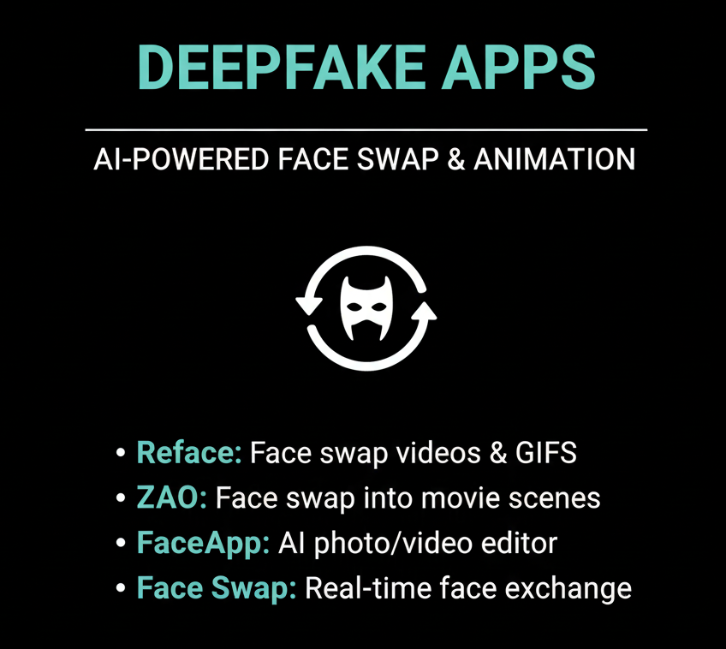

Slide 33
