Slide 1
Taking Effective Meeting Minutes
OkACTE Leadership Conference
Karen Nail
SouthernTech
Executive Assistant

Slide 2
Introduction
Karen Nail – I support the Superintendent, Assistant Superintendent, and Board of Education at SouthernTech in Ardmore.
Experience:
  Minutes Clerk for SouthernTech
  CTAC recording secretary
My goal is to share some practical tips that have made minute taking easier for me, in hopes that they will also benefit you.
Notes:
Who in here has ever taken minutes for a meeting? Who currently takes minutes for a meeting? My name is Karen Nail… You might be

Slide 3
Why Minutes Matter
Meeting minutes matter because they’re the official notes of what happened. Think of them as the “receipt” for the meeting. They show what was decided, who’s responsible, and serve as a reliable record so nothing gets lost or forgotten.
Provides an official record –minutes document what was discussed, decided, and assigned
Tracks accountability – Assignments and action items are clearly recorded.
Inform those who weren’t there – ensures those who couldn’t attend are informed
Provide a record – months later, you can look back and see why a decision was made
Notes:
So, let’s get started. Meeting minutes matter because they are considered the official record of your meeting. Think of them as a “receipt” for the meeting. They will show what was decided, who’s responsible, and serve as a reliable record so nothing gets lost or forgotten. Have you ever left a meeting thinking one thing was decided, but later found out others remembered it differently? You can look back at your minutes and it should tell a story of what went on. - if someone missed a meeting and wanted to know what went on, the should be able to read your minutes and know what decisions where made, who is responsible for certain tasks, what actions were taken – they should feel they didn’t miss a thing by reading your minutes.

Slide 4

Pre-game/Game/Post-Game
Pre-Game (before the meeting): Know the agenda, use a template if that helps.
Game (during the meeting): Capture motions, action items, decisions. Don’t get lost in details.
Post-Game (after the meeting): Polish, distribute promptly, keep formatting consistent.
Notes:
A lot of people think taking minutes are just sitting in a meeting writing notes. There’s actually more to it than that – a before during and after and that’s what I’m going to talk about today. This is just a brief overview.

Slide 5
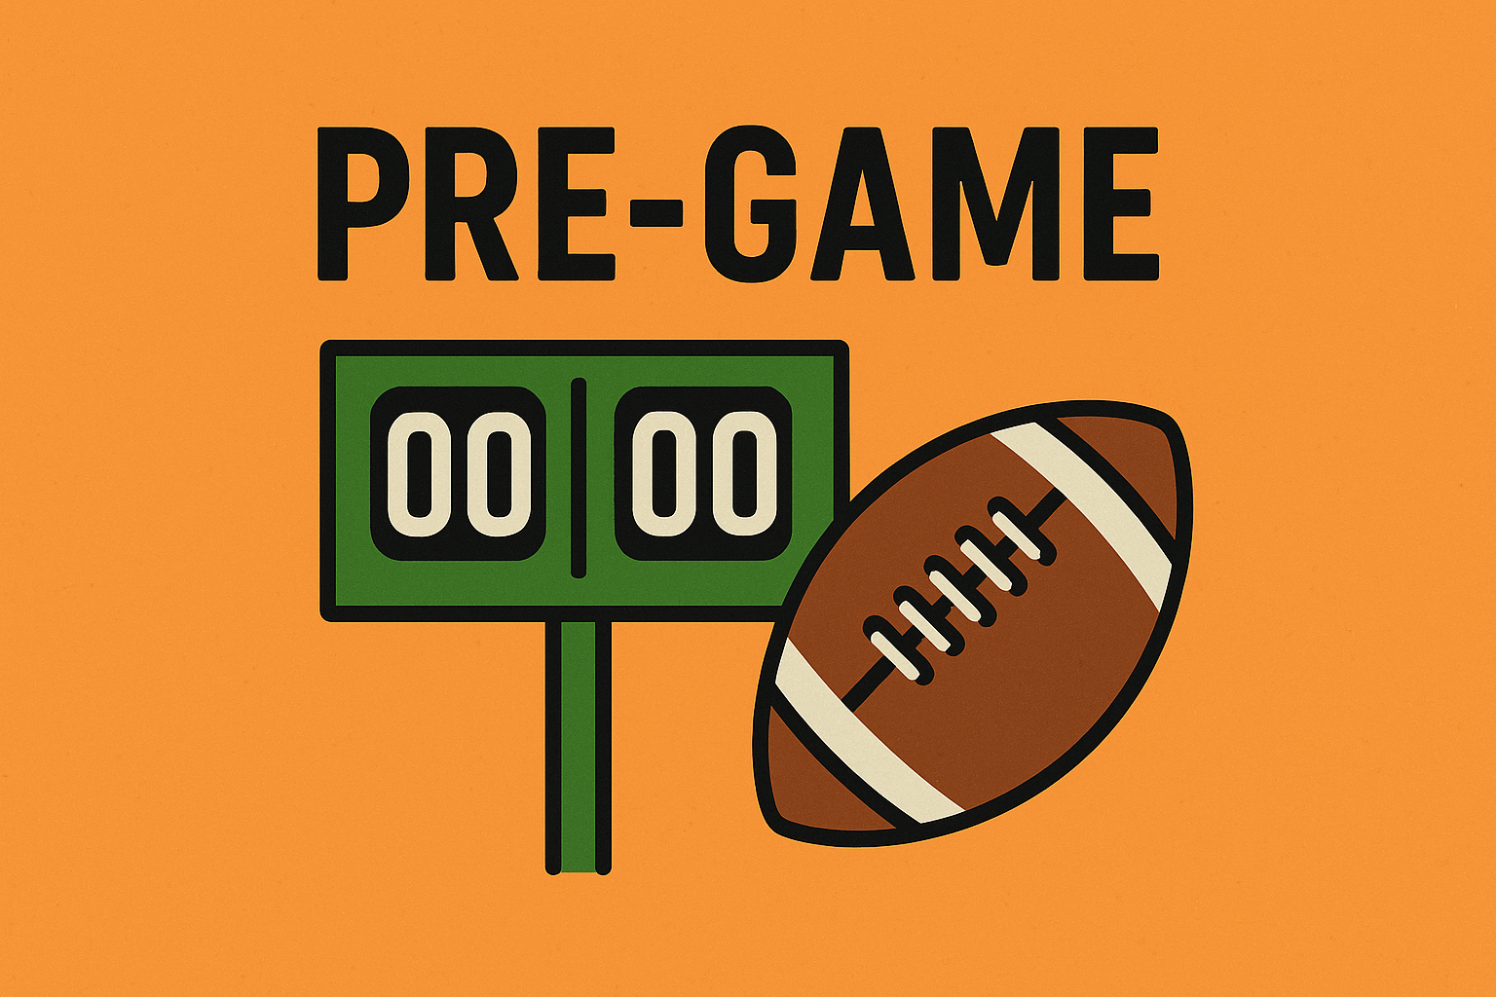
Preparing Before the Meeting
Know the Agenda – if you’re not the one who made the Agenda, make sure you’ve had the chance to look over it before the meeting to anticipate any key points and where the action items are.
Highlight the action items so you don’t forget where a vote is needed (such as adjourning the meeting).
Make a template from the agenda
Make sure you have all essential tools for taking notes, such as laptop, notebook, pens/pencils, and/or recording device.

Slide 6
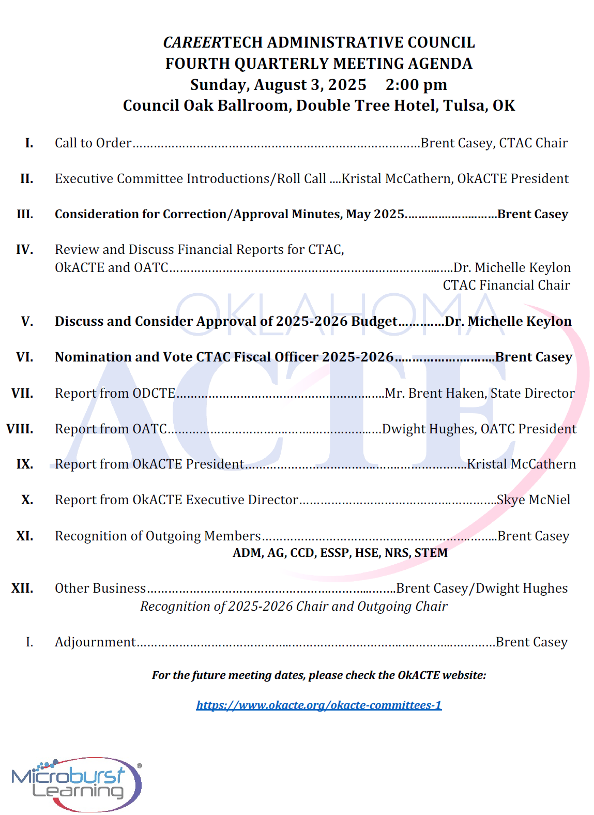

Slide 7
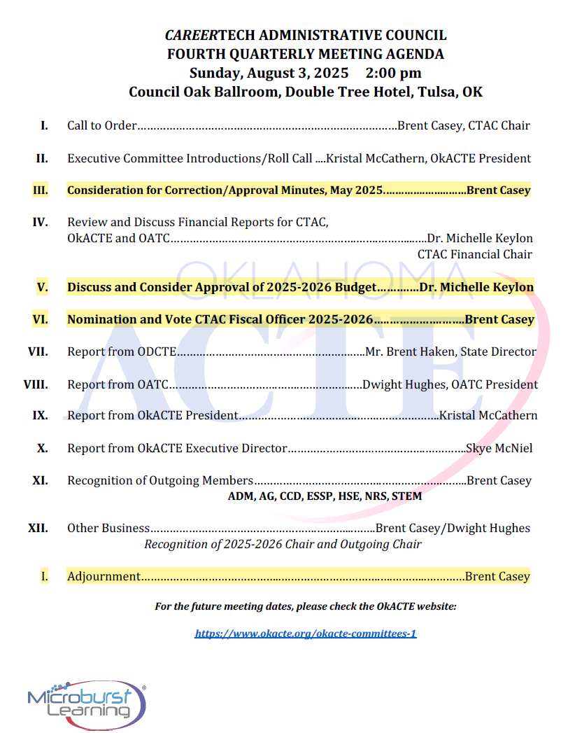

Slide 8
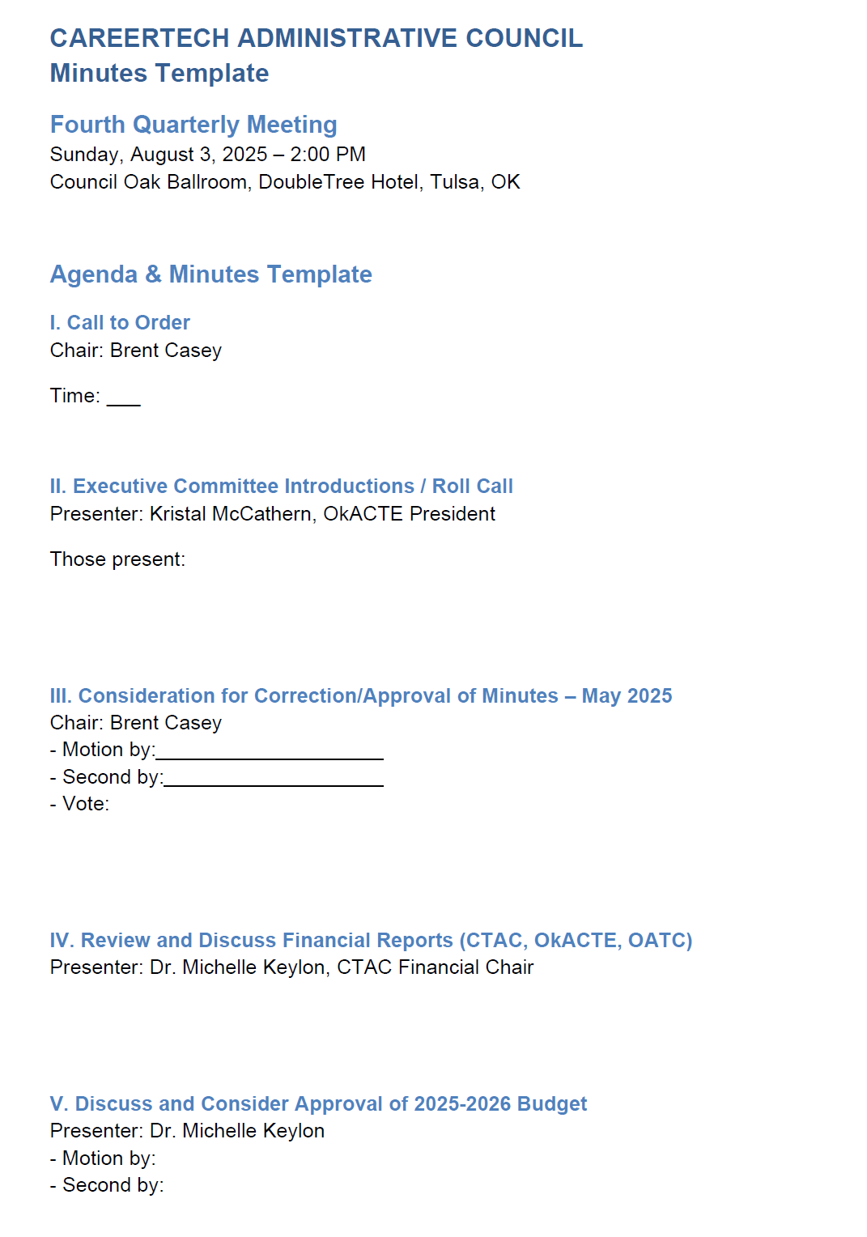
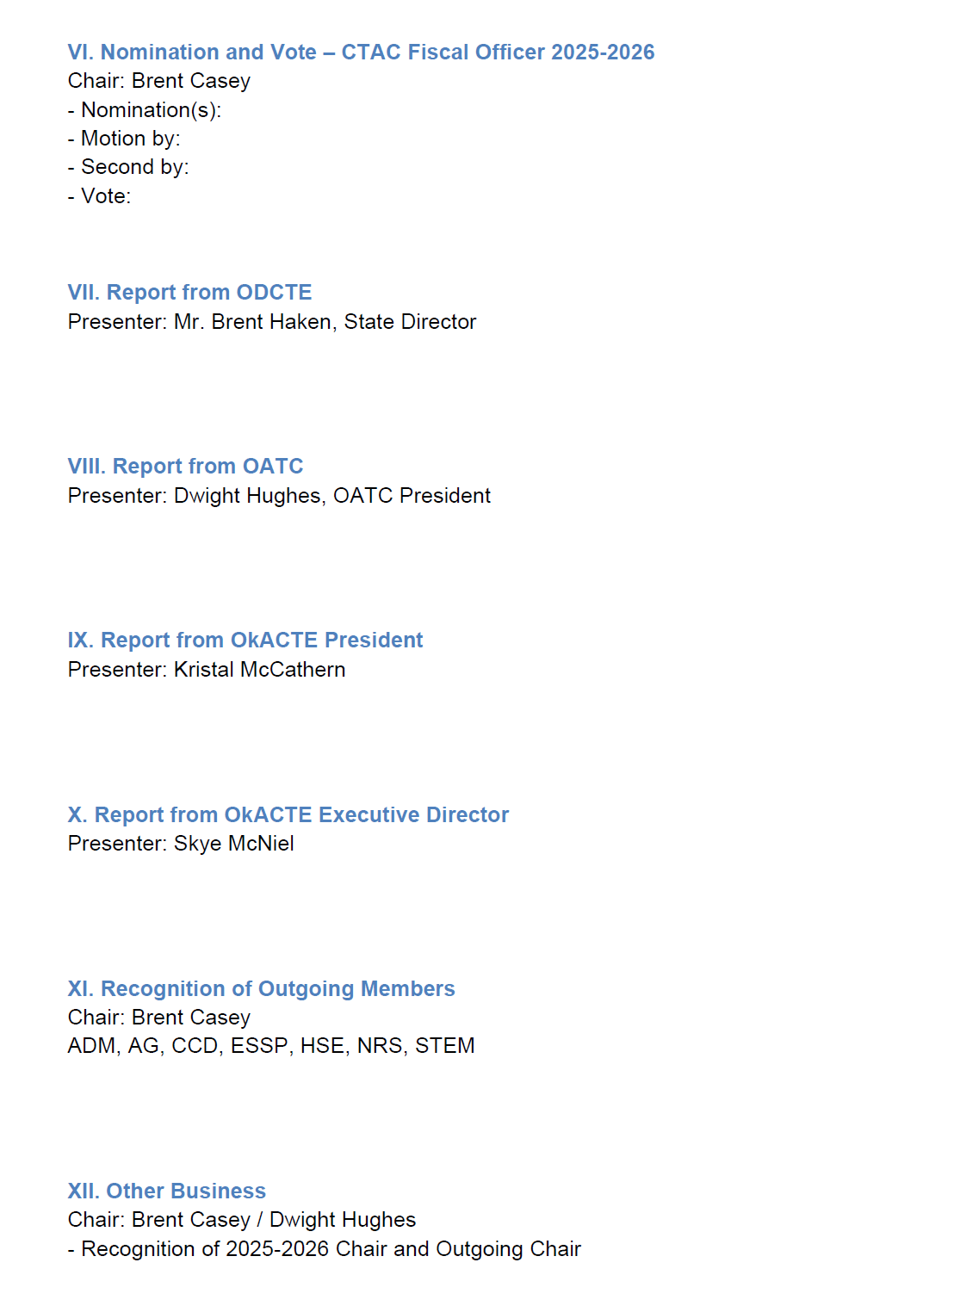
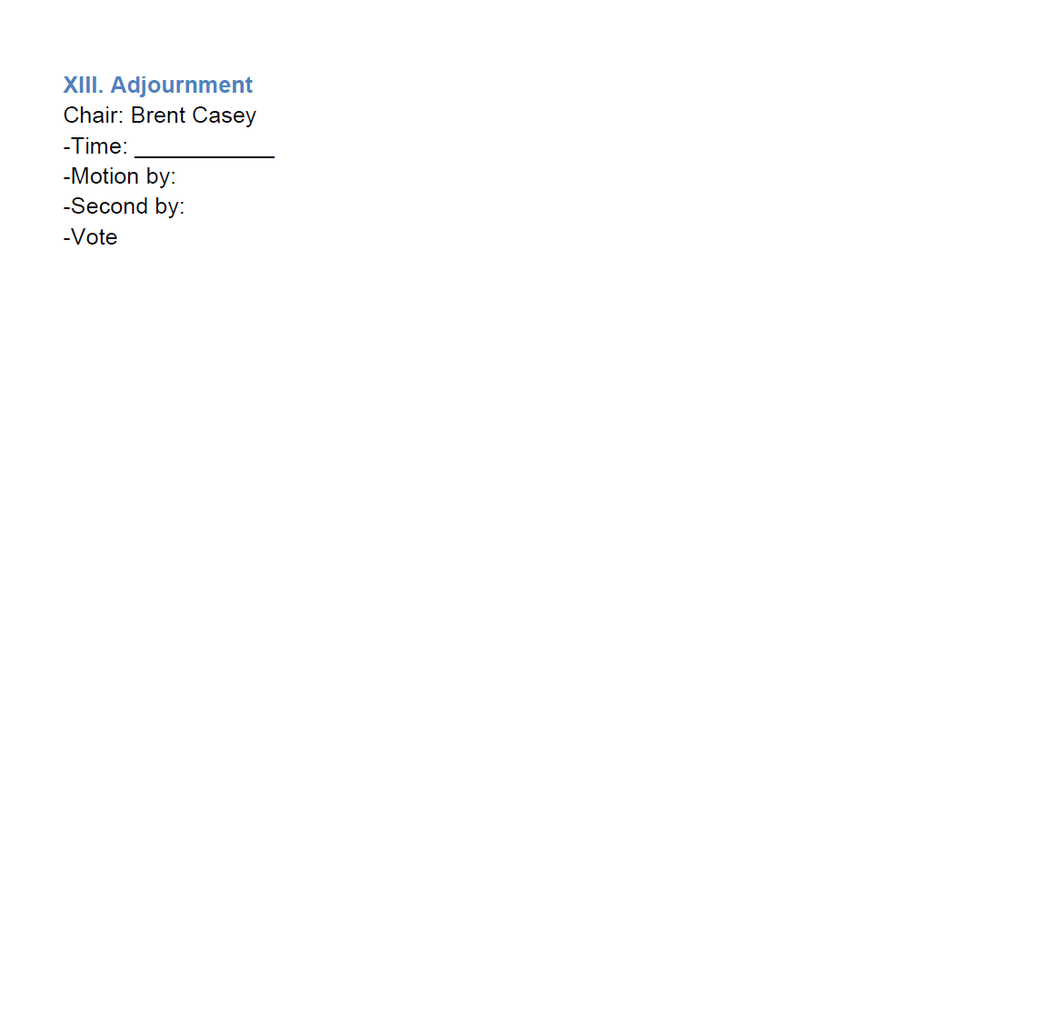

Slide 9

During the Meeting
Listen but don’t get lost in details – don’t overthink ☺
Pay attention to the key points.
Example: If someone spends five minutes explaining why a project is delayed, you don’t need to write down the whole story.
You’d simply note: “Project X delayed; new deadline September 30. John will follow up with vendor.”
Capture motions/votes on action items
Example: On a motion by Heather Black and seconded by Sheri Taylor, with approval by all members, the minutes from the May 8, 2025, CTAC meeting were approved as presented.
Capture any decisions made
* Approving a budget or proposal
* Choosing a date for an event
* Agreeing on next steps for a project
I usually have my laptop, my agenda/agenda template
where I take notes, iPhone for recording
Notes:
Don’t get caught in the details. I have a hard time sometimes during the CTAC meeting updates from Director Haken and Skye because they typically have a lot of updates, especially legislatively. You’ll see in a few minutes when I show you the slide of the minutes from our last CTAC meeting.

Slide 10

After the Meeting
Get the minutes done as soon as possible – details are still clear, accurate information is not forgotten. Keep the formatting consistent.
Keep them concise – no one likes reading a novel. Be short, clear, and to the point. People reading minutes don’t want (and usually won’t read) pages of long-winded detail – they just want the essentials.
Have someone proof-read them, if needed
Distribute to appropriate person promptly. If you’re the recording secretary for your division, I would keep a digital file as well as a binder with previous agendas, meeting minutes, and notes for reference.
Remember – the minutes are considered “tentative” or “draft” until they are approved at the next meeting by the voting members.

Slide 11
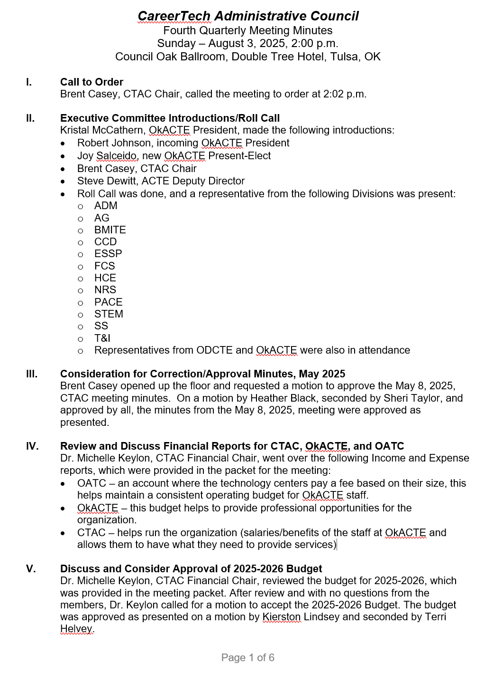
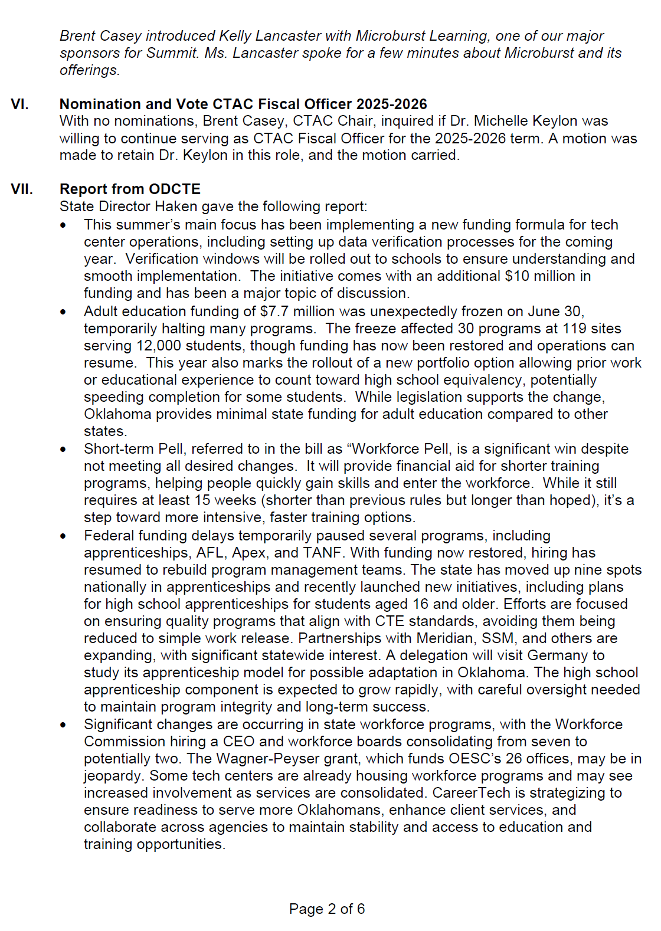

Slide 12
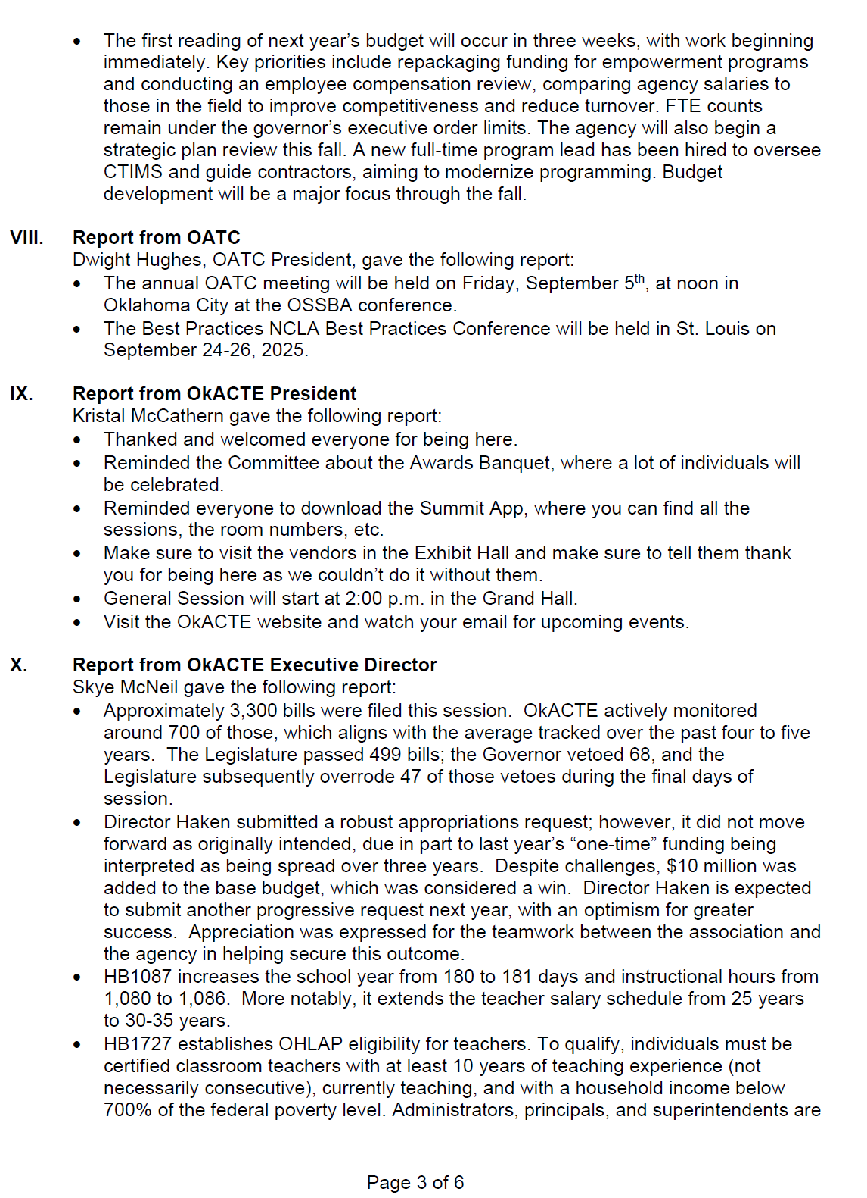
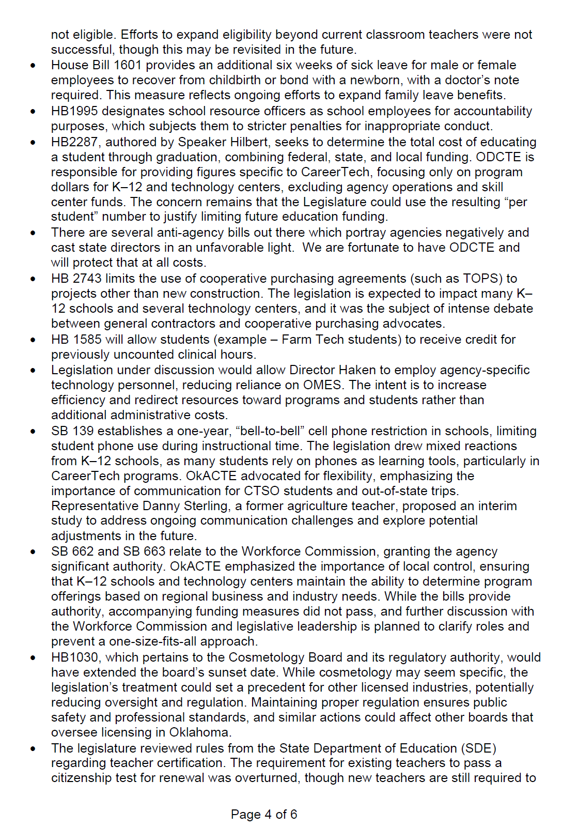

Slide 13
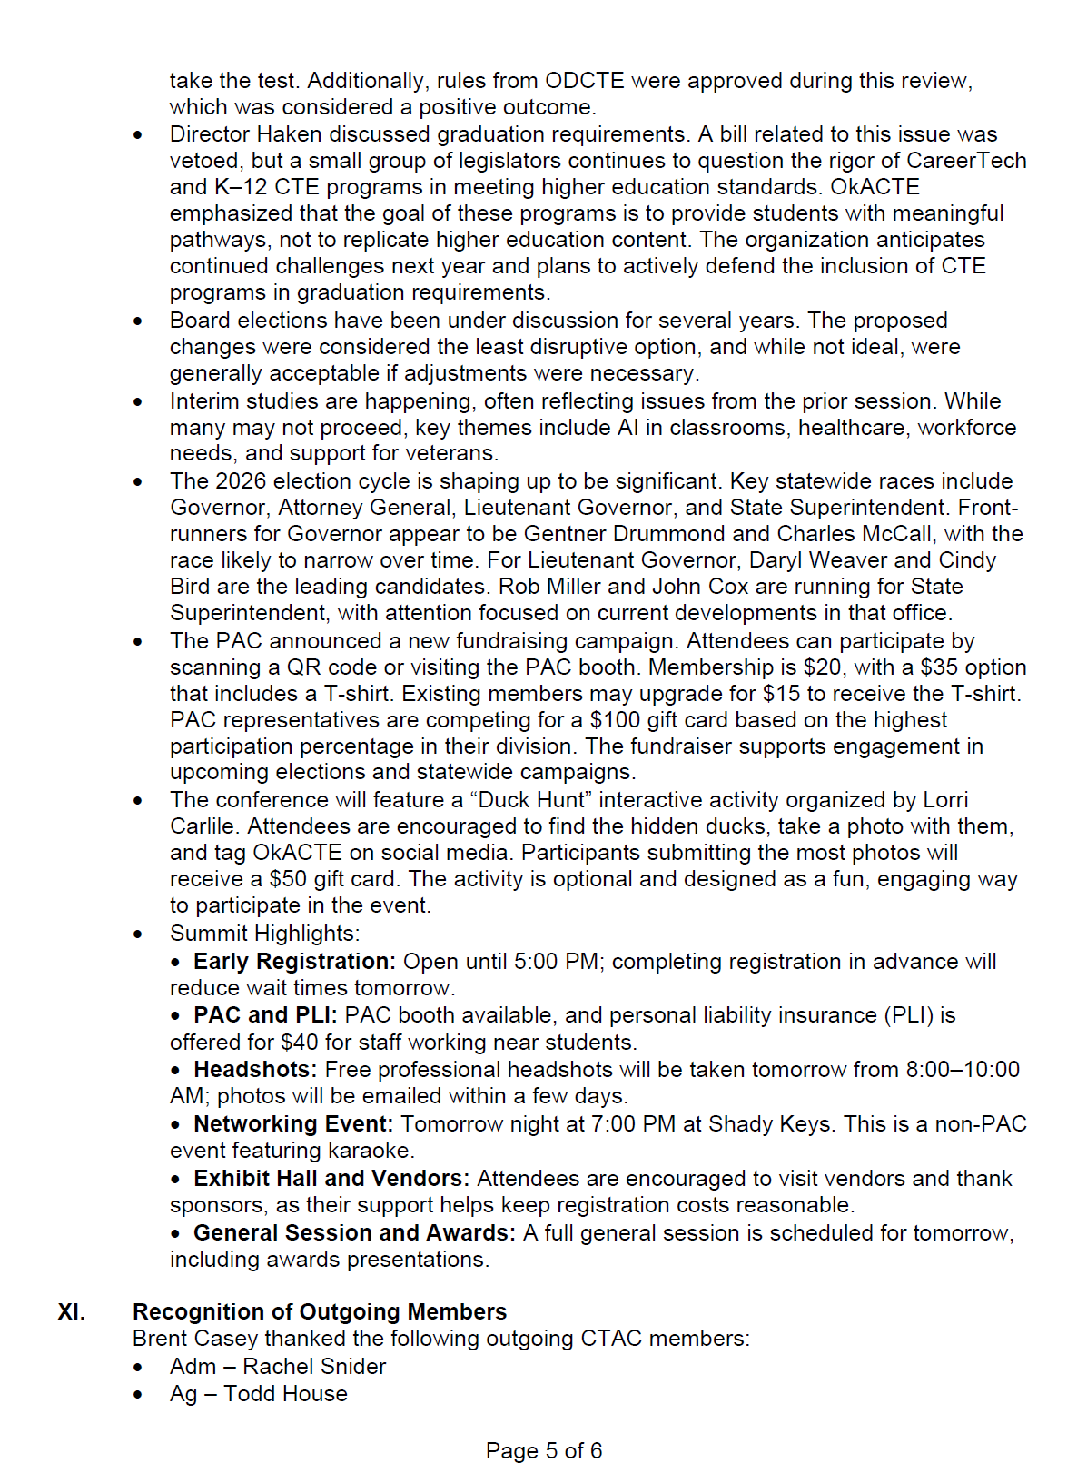
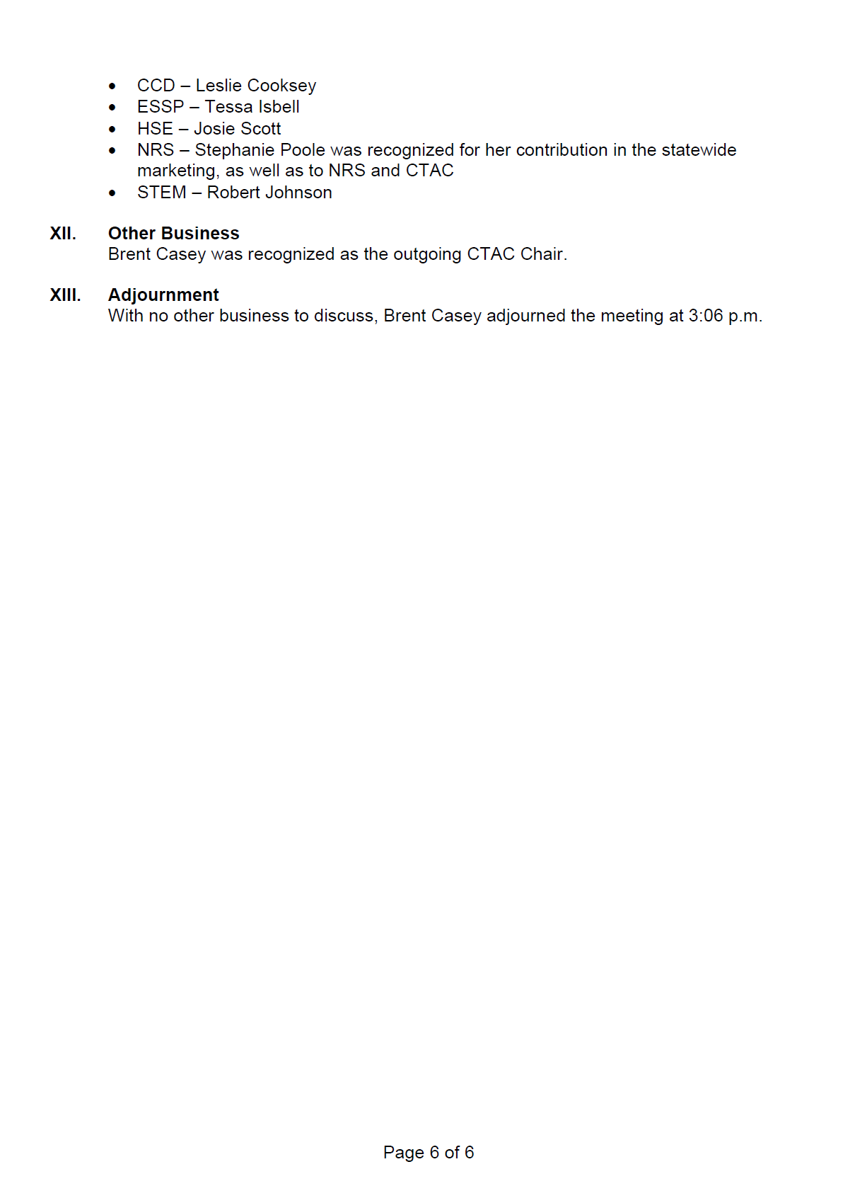

Slide 14
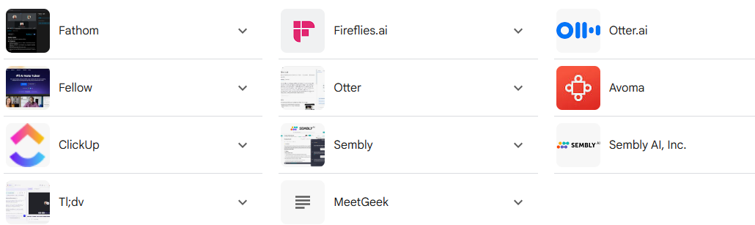
Practical Tips & Tools
Let ChatGPT be your friend – helpful when needing to summarize
Use tech if allowed
Always good to have a back up note-taker, if possible
Save minutes in a shared, accessible place
Apps for summarizing minutes:

Slide 15

Has anyone tried AI or any of the AI tools?
Does anyone have any other tips that have helped that you want to share?
Questions?

Slide 16
